Slide 1
EFFICIENT REPERESENTATION OF CONDITIONAL DISTRIBUTION
G.VAISHNAVI-22WH1A6658
K.SREEJA-22WH1A6657

Slide 2
WHAT IS CONDITIONAL PROBABILTY?
Conditional probability distribution is a fundamental concept in the field of probability and statistics that describes the probability of an event occurring given that another event has already occurred.
It is the probability of an event (A), given the occurrence of another event (B). It is denoted as P(A|B), which reads as "the probability of A given B.“

Slide 3
CONDITIONAL PROBABILITY DISTRIBUTION
A conditional probability distribution, then, is a probability distribution for a subset of the sample space, conditioned on the occurrence of a particular event. It gives us a complete description of the probabilities of the possible outcomes of a random variable, given that a certain condition is met.
In probability theory and statistics, the conditional probability distribution is a probability distribution that describes the probability of an outcome given the occurrence of a particular event
We can represent the conditional distribution in more efficient way by utilizing deterministic nodes (no uncertainty)

Slide 4
Types of conditional probability distribution
There are two main types of conditional probability distributions:
Discrete Conditional Probability Distribution:
This is used when dealing with discrete random variables, which are variables that take on a countable number of distinct values. The distribution is defined by a probability mass function (PMF) that assigns probabilities to each possible value of the random variable, given the condition.
Continuous Conditional Probability Distribution :
This is used for continuous random variables, which can take on any value within a range. The distribution is defined by a probability density function (PDF) that describes the relative likelihood of the random variable to take on a given value, given the condition.

Slide 5
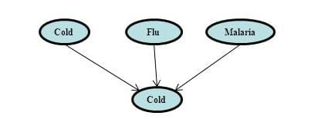
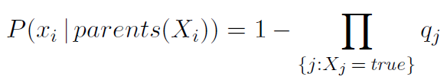
E.G.: Fever Is Caused By Cold, Flu, Or Malaria, But A Patient Could Have A Cold, But Not Exhibit A Fever.
q(cold) = P(˜ fever | cold, ˜ flu, ˜malaria) = 0.6
q(flu) = P(˜ fever | ˜cold, flu, ˜malaria) = 0.2
q(malaria) = P(˜ fever | ˜cold, ˜flu, malaria) = 0.1

Slide 6
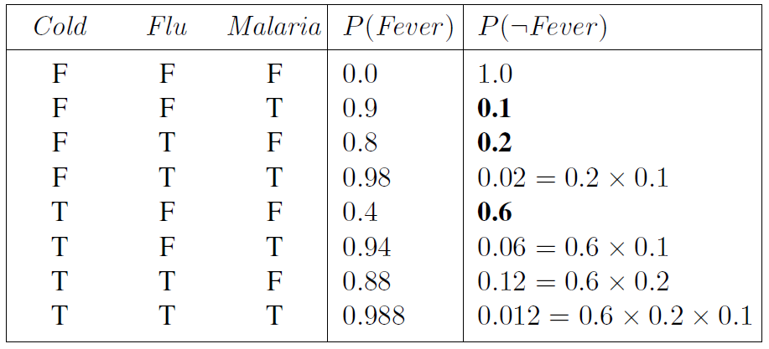

Slide 7
Sports Betting : Conditional Probability Is Frequently Used By Sports Betting Companies To Determine The Odds They Should Set For Certain Teams To Win Certain Games. SALES FORECASTING : Retail companies use conditional probability to predict the chances that they’ll sell out of a certain product based on product promotions. TRAFFIC : Traffic engineers use conditional probability to predict the likelihood of traffic jams based on stop light failures.
EXAMPLES

Slide 8
APPLICATIONS
Conditional probability distributions are widely used in various fields. Here are a few examples:
Finance: In financial risk assessment, conditional probability distributions can be used to model the likelihood of default on a loan, given the borrower's financial history.
Healthcare: Medical professionals use conditional probability distributions to determine the likelihood of a disease given certain symptoms or test results.
Weather Forecasting: Meteorologists use conditional probability distributions to predict weather events based on current atmospheric conditions.

Slide 9
CONCLUSION
Conditional probability distribution is a key concept in statistics that allows for more informed predictions and decisions by considering the influence of known events.
Understanding and correctly applying conditional probability distributions can provide significant insights and advantages across a wide range of fields. However, it is crucial to be aware of the assumptions and limitations associated with these distributions to ensure accurate and reliable results.

Slide 10
THANK YOU

